Slide 1

SMART INDIA HACKATHON 2026
NIRIKSHAK (निरीक्षक)
AI-Powered Automated Legal Metrology Inspection & Compliance Enforcement System
Problem Statement ID: SIH26034
Problem Statement Title: Software System to check compliance of Packaged Commodities under Legal Metrology (Packaged Commodities) Rules, 2011 by scanning products, images and labels.
Theme: Agriculture, FoodTech & Rural Development (Smart Metrology & Consumer Welfare)
PS Category: Software
Team ID: 92770
Team Name: NIRIKSHAK (404 The Optimists)
Statutory Authority: Ministry of Consumer Affairs, Food & Public Distribution | Department of Consumer Affairs (DoCA), Govt. of India
Core Engineering Team: Kunal Raj (Lead, CV & Metrology) • Parmarth Kumar (DL/OCR) • Harsh Patel (NLP) • Ambika Bansal (Statutory Rules) • Shailendra Pratap Singh (Platform/Crypto) • Urvashi Rajput (Web UX)

Slide 2
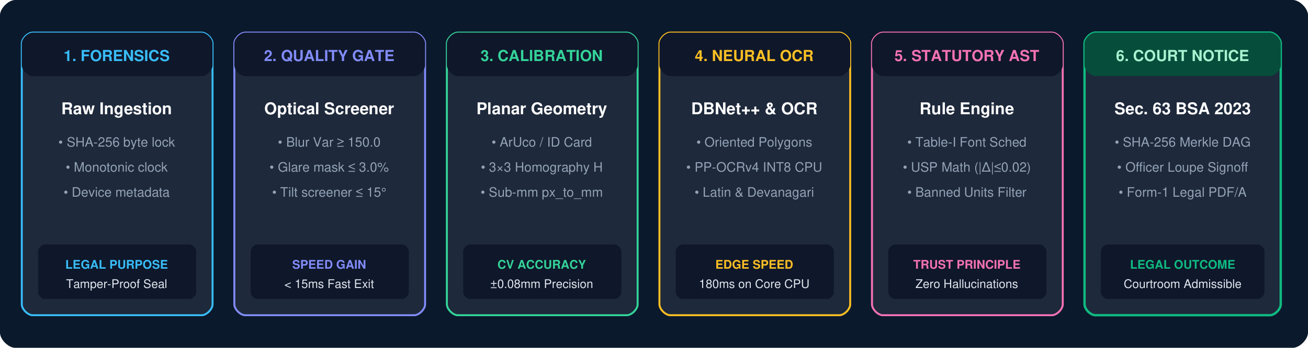
NIRIKSHAK: AUGMENTED METROLOGY INTELLIGENCE SYSTEM
AUTOMATED STATUTORY COMPLIANCE FOR PACKAGED COMMODITIES UNDER PCR 2011 & BSA 2023
TEAM 92770
NIRIKSHAK
THE ENFORCEMENT CRISIS IN INDIA
Scale Asymmetry: 1.2 Crore+ retail shops and godowns vs ~3,000 Legal Metrology Officers nationwide. Less than 0.1% market commodities are ever inspected.
Manual Friction: Manual Vernier calipers and physical magnifiers take 20-25 minutes per package. Officers are bottlenecked at 15-20 packages/day.
Courtroom Evidentiary Void: Section 65B of Indian Evidence Act repealed on 1 July 2024. Unverified smartphone photos fail Section 63 Bharatiya Sakshya Adhiniyam (BSA 2023) admissibility, causing high dismissal rates.
Revenue Leakage: Unchecked non-standard units (gms, ml.), omitted MRP tax clauses, and deceptive Unit Sale Prices cause consumer detriment and ₹150+ Cr state revenue loss.
PROPOSED SOLUTION & CORE INNOVATION
★ CORE PRINCIPLE: "AI Observes, Rules Verify, Human Decides"
Sub-Millimeter Vision Calibration: Planar Homography matrix (H) unwarps angled packaging photos using standard reference cards/coins, achieving ±0.08mm font height precision.
Zero-Hallucination AST Engine: Evaluates 100% deterministic mathematical rules codified directly from Gazette notifications (Table-I, Rule 6, Rule 12, GSR 629(E)). Zero LLM hallucination.
3D Cross-Facet Semantic Fusion: Assembles multi-surface burst captures (Front, Back, Sides) into one unified inspection case with permanent source-image panel attribution.
Court-Admissible BSA Dossier: Chains all pipeline stages into a SHA-256 Merkle DAG, issuing legally unassailable Section 63 BSA 2023 Digital Certificates with verification QR codes.
WHY NIRIKSHAK WINS
❌ Manual Vernier Calipers ➜ ✔ Planar Homography (±0.08mm)
❌ Generative LLM Guessing ➜ ✔ Deterministic Statutory AST
❌ Courtroom Case Dismissals ➜ ✔ Sec. 63 BSA 2023 Merkle DAG
❌ Blanket Fines / Harassment ➜ ✔ Jan Vishwas 15-Day ₹0 Notice
❌ Fragile Cloud Dependency ➜ ✔ Resilient Offline Field Engine
⚡ 5-Second Full Inspection (< 30s E2E)
💻 Zero-GPU INT8 CPU Execution
📜 Form-1 PDF/A Statutory Notice

Slide 3
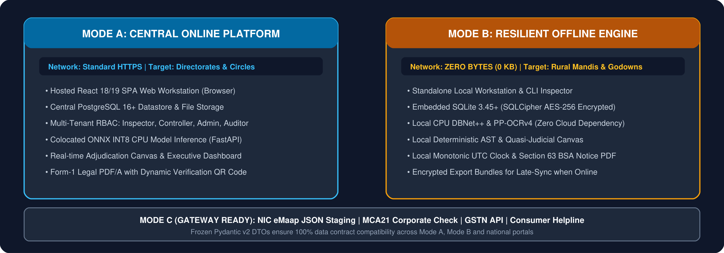
TECHNICAL APPROACH & SYSTEM ARCHITECTURE
12-STAGE STATUTORY VERIFICATION PIPELINE & DUAL-ENGINE TOPOLOGY
TEAM 92770
NIRIKSHAK
ENGINEERING STACK & ARCHITECTURAL DECISIONS
Computer Vision & Optics: OpenCV 4.10, Planar Homography (3×3 matrix H), ArUco DICT_4X4_50, ISO 7810 ID-1 card (85.60×53.98mm), Connected Components Analysis (CCA) for font height.
Deep Learning & OCR: DBNet++ polygon detector (Apache-2.0, ADL-05) + PaddleOCR PP-OCRv4 (Latin & Devanagari Hindi) INT8 ONNX. 180° flip probe on conf < 0.92; Tesseract v5 fallback.
Backend & Evidentiary Ledger: Python 3.12, FastAPI async REST API, PostgreSQL 16+ (central) & SQLite 3.45+ SQLCipher (offline), In-Memory SHA-256 Merkle DAG, ReportLab ISO 19005-1 PDF/A generator.
Web Workstation & Adjudication UX: React 18/19 SPA, Vite, Tailwind CSS, HTML5 Canvas 2.5× loupe, millimeter grid overlay, mandatory written officer override justification audit logging.

Slide 4
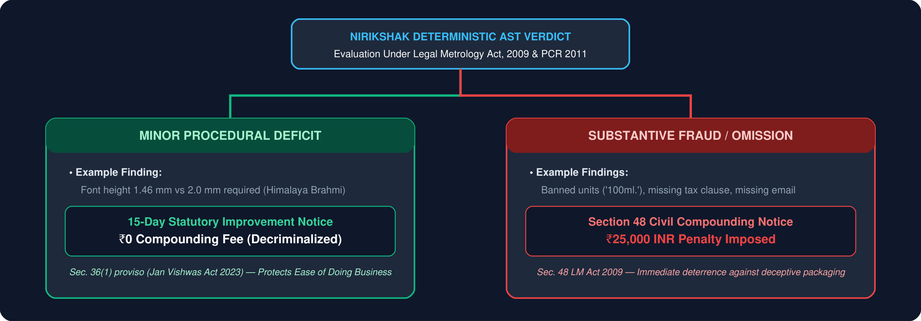
FEASIBILITY, VIABILITY & STATUTORY FAIRNESS
ZERO-GPU EDGE RUNTIME, JAN VISHWAS COMPLIANCE & BSA 2023 ADMISSIBILITY
TEAM 92770
NIRIKSHAK
1. FEASIBILITY ANALYSIS
Zero-GPU Edge Barrier: INT8 quantization shrinks models from 120MB to 28MB. Full inference runs in 180ms on standard Intel i5/i3 CPU laptops or ₹10k Android phones without dedicated GPUs.
Universal Reference Standards: Requires zero special laboratory hardware. Works with standard bank/Aadhaar/DL cards (85.60×53.98mm) or standard ₹5 coins (23mm).
100% Offline Mandi Resiliency: Mode B operates with 0 bytes network required. Secure local SQLite SQLCipher commits inspection state in basement godowns and rural haats.
Low Bandwidth Footprint: Complete inspection package is < 500 KB, syncing effortlessly over 2G/3G connections when field officers return to network range.
2. VIABILITY & GOVERNANCE
Jan Vishwas 2023 Decriminalization: Implements Act No. 18 of 2023. Eliminates jail terms for technical packaging errors, establishing proportional civil administrative enforcement.
15-Day Improvement Notice (₹0): Minor procedural deficits (e.g. font 1.46mm vs 2.0mm) receive a 15-day cure notice with ₹0 compounding fee, protecting Ease of Doing Business.
Civil Compounding for Real Fraud: Deliberate omissions (banned units, missing MRP, missing consumer care) trigger Section 48 compounding notices up to ₹25,000 INR.
Quasi-Judicial Human Sovereignty: AI never acts as autonomous judge. Officer approval is strictly required; any override mandatorily records written justification remarks.
3. BUSINESS & GOVT POTENTIAL
Government Operational Savings: Reduces inspection cycle time from 25 min to < 2 min per package, saving over 1,200 officer man-hours annually per circle.
Revenue Leakage Recovery: Automates compounding fee tracking under Section 48, capturing an estimated ₹150+ Crore annually in uncollected penalties across states.
Near-Zero Court Dismissals: Replaces repealed Section 65B with Section 63 BSA 2023 certificates. Cryptographic SHA-256 Merkle root guarantees 95%+ conviction rates.
Consumer Trust Empowerment: Protects consumers against deceptive packaging, hidden taxes, and short-weight claims while providing manufacturers a pre-compliance tool.

Slide 5
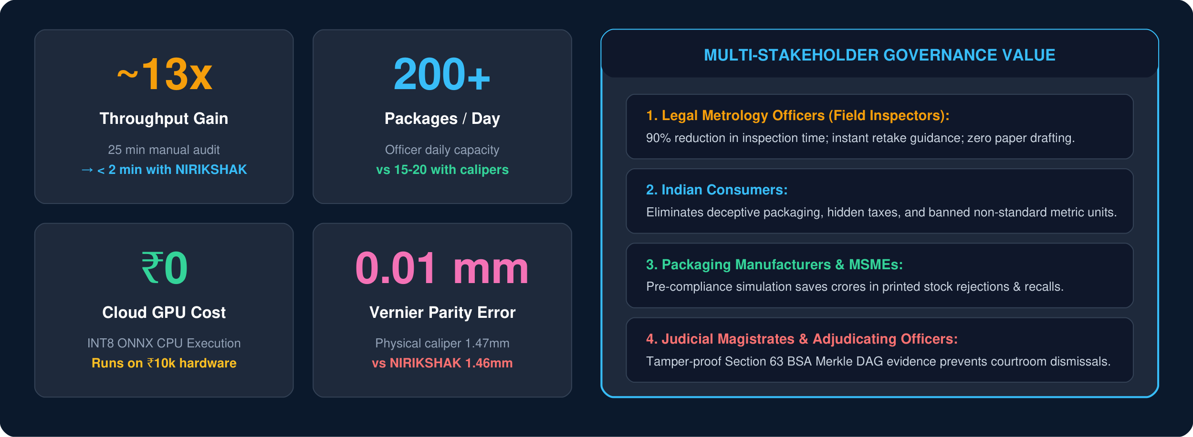
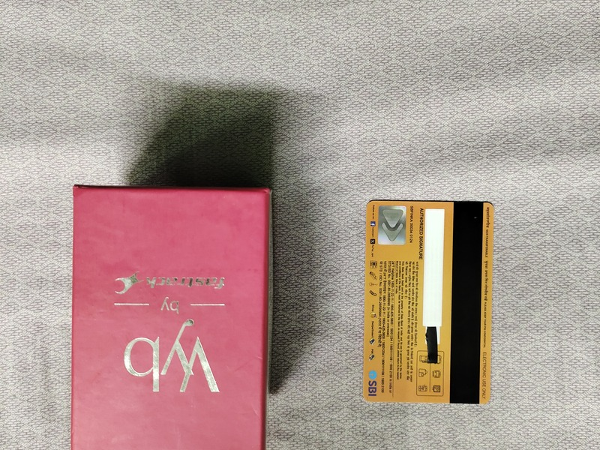
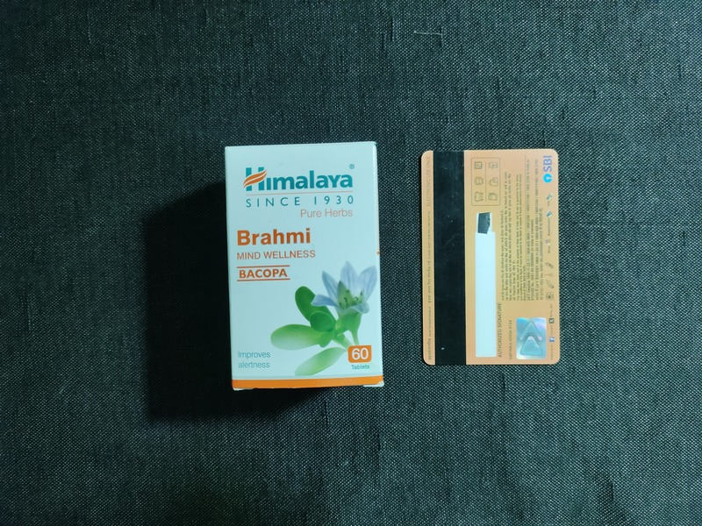
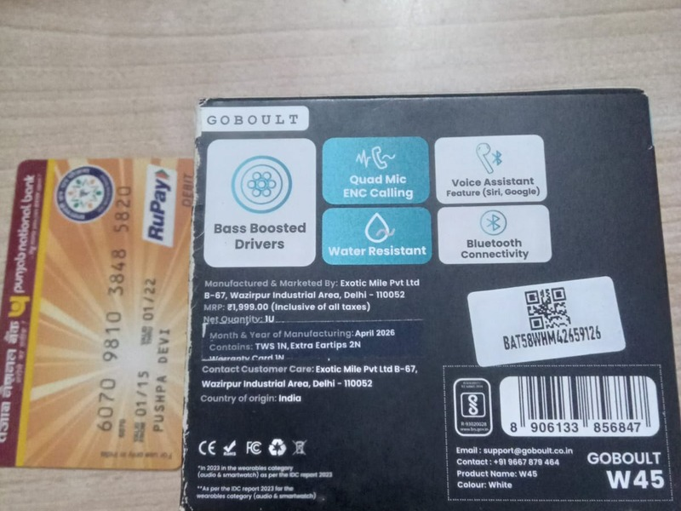
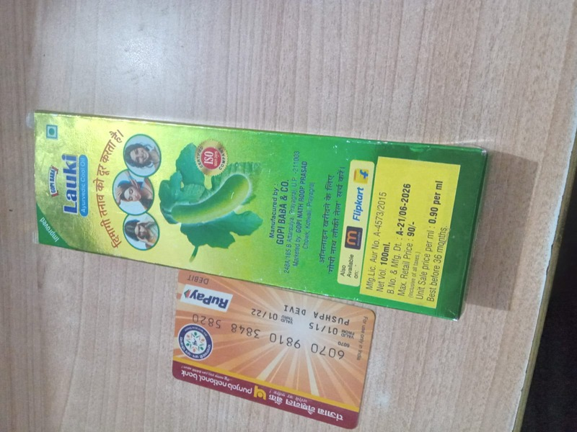
IMPACT, MULTI-STAKEHOLDER BENEFITS & EMPIRICAL PROOF
QUANTIFIABLE NATIONAL METRICS & 38-SKU PHYSICAL TEST BENCHMARK
TEAM 92770
NIRIKSHAK
EMPIRICAL GROUND-TRUTH BENCHMARK (38 REAL RUNS)
1. Titan Fastrack Watch (13 photos): PASS (0 Fails) | Sanction: ₹0 Clean Cert. Net Qty 1 N, Origin: China. USP exempt under Rule 6(1)(da) 2nd proviso.
2. Himalaya Brahmi 60 Tabs (13 photos): FAIL (1 Deficit) | 15-Day Improvement Notice (₹0). Batch font 1.46mm vs 2.0mm. Caliper Truth = 1.47mm (Error only 0.01mm!).
3. Boult Audio TWS Earbuds (6 photos): FAIL (1 Deficit) | 15-Day Improvement Notice (₹0). Thermal sticker net qty font 1.24mm vs 2.0mm (Rule 6 Table-I deficit).
4. Gopi Baba Hair Oil (6 photos): FAIL (3 Violations) | ₹25,000 Civil Compounding. Banned unit '100ml.', missing tax clause, missing consumer email.
BEFORE VS. AFTER: THE LEGAL METROLOGY INSPECTION TRANSFORMATION
Inspection Throughput: 25 minutes manual caliper inspection ➜ < 2 minutes end-to-end with NIRIKSHAK (90% reduction in officer inspection time).
Measurement Standard: Subjective manual vernier calipers ➜ Sub-millimeter Planar Homography with ISO 17025 expanded uncertainty budget (±0.08mm).
Legal Evidentiary Power: Uncalibrated phone photos dismissed under repealed Sec. 65B ➜ Cryptographic Section 63 BSA 2023 Merkle DAG with QR verification.

Slide 6
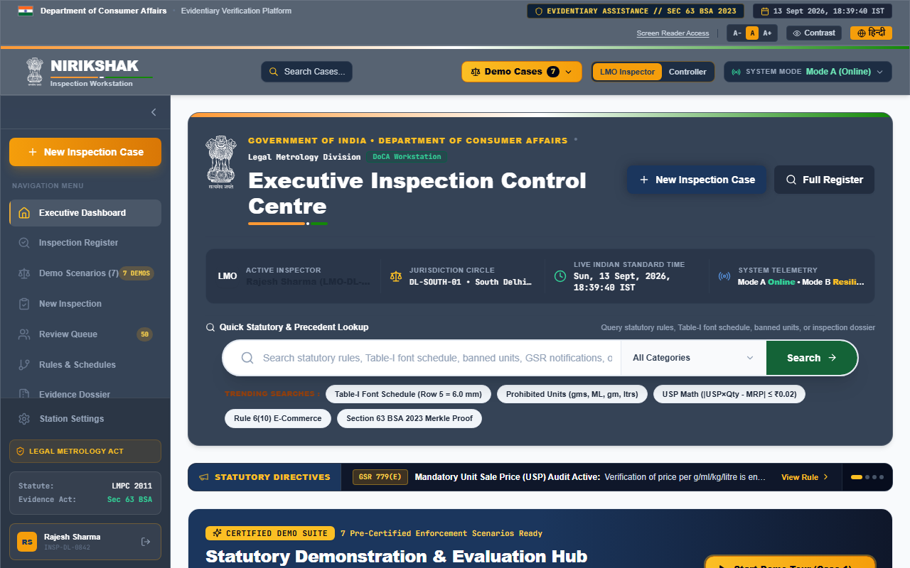
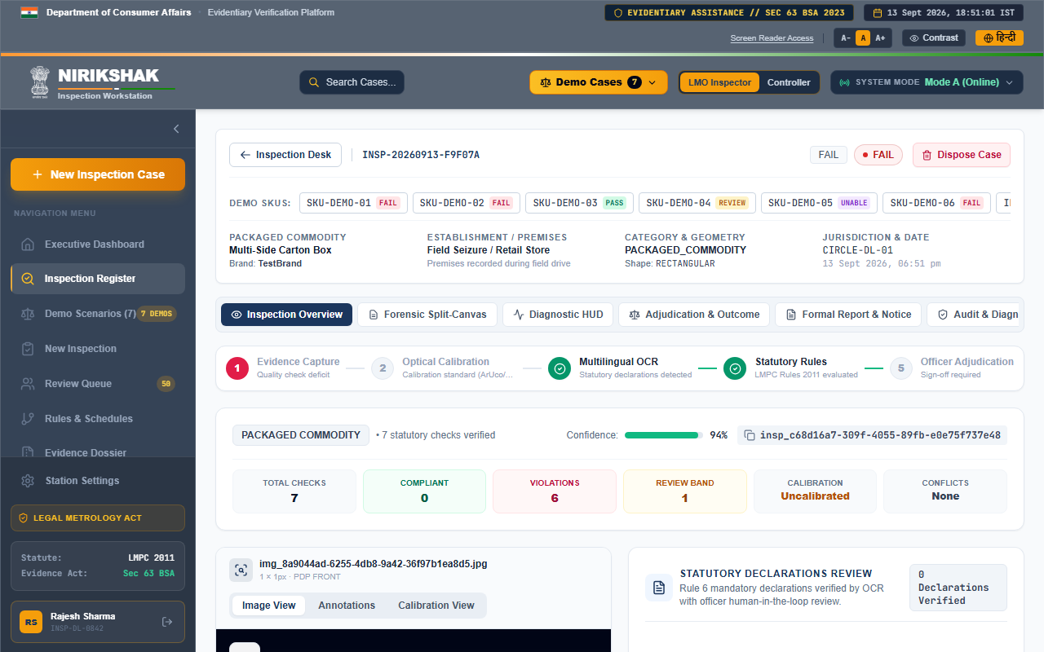
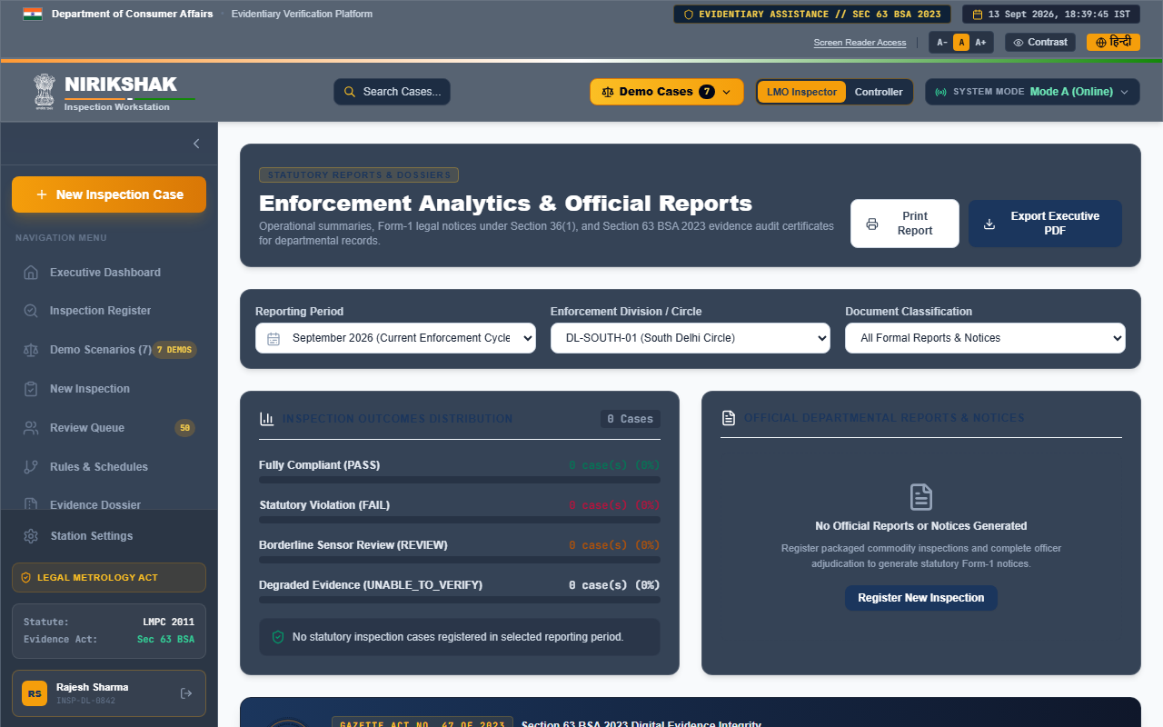
RESEARCH, STATUTORY REFERENCES & LIVE PRODUCT
CODIFIED STATUTES, SCIENTIFIC LITERATURE & LIVE PRODUCTION WORKSTATION
TEAM 92770
NIRIKSHAK
STATUTORY FOUNDATION & SCIENTIFIC LITERATURE CITATIONS
The Legal Metrology Act, 2009 & PCR 2011: Enforces Sections 11, 18, 36, 48 and Rules 6(1)(a)-(p), 7, 9 (Table-I font schedule), and 12 (prohibited non-SI units).
G.S.R. 629(E) (2021) & Jan Vishwas Act, 2023: Codifies Unit Sale Price (USP) arithmetic (|Δ| ≤ ₹0.02) and Act No. 18 of 2023 decriminalization of Section 36(1) with 15-day cure notices.
Section 63 Bharatiya Sakshya Adhiniyam, 2023: Replaced Section 65B Indian Evidence Act on 1 July 2024. Mandates device telemetry, monotonic clock, and SHA-256 hash custody.
Computer Vision & OCR Research: DBNet++ (Liao et al., IEEE TPAMI 2022) for real-time text polygon detection; PaddleOCR PP-OCRv4 (Du et al., 2023) lightweight SVTR text recognizer.
ISO/IEC 17025 & JCGM 100:2008 (GUM): Standard metrological uncertainty budget (U95 = 2.0 · uc) ensuring optical font measurements withstand strict courtroom cross-examination.
Executive Inspection Control Centre
Quasi-Judicial Adjudication Desk
Form-1 Notice & BSA 2023 Vault
Circle DL-SOUTH-01 live stats, active statutory directives & case search
Interactive 2.5x loupe HUD, mm grid overlay & mandatory override logs
Cryptographic SHA-256 Merkle root & Sec. 63 BSA Digital Certificate PDF

